Slide 1



NM EDD FUNDIT Webinar Series:
NM Broadband Overview
Nm economic development department finance team
Juan Torres, Johanna Nelson
7/26/2017

Slide 2
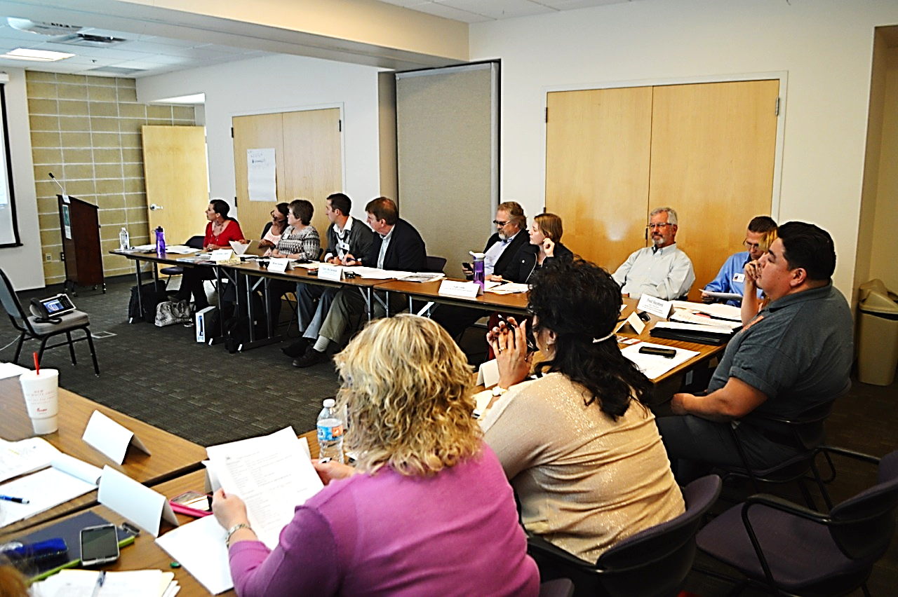

FUNDIT Overview
Eligible projects include:
  Business development such as incubators, industrial parks
  Community development such as feasibility studies, comprehensive plans
  Infrastructure development
  Housing
  Downtown revitalization
FUNDIT is an informal group of Federal and State entities which meets bi-monthly to help communities find funding opportunities for infrastructure and economic development projects.

Slide 3

FUNDIT Partners

Slide 4
Upcoming FUNDIT Meeting
August 22nd @ WESST in Albuquerque
1:30-3:30
*Cut-off for applications is Aug. 11th
Apply: https://gonm.biz/business-resource-center/edd-programs-for-business/finance-development/fundit/
FUNDIT Project List on Ristra Project: http://www.ristraproject.com/site/2215

Slide 5
Broadband:
National Telecommunications and Information Administration (NTIA
The American Recovery and Reinvestment Act (ARRA) provided a total of $7.2 billion to the National Telecommunications and Information Administration (NTIA) and the Department of Agriculture’s Rural Utilities Service (RUS) to fund projects that would expand access to and adoption of broadband services across the United States.
NTIA utilized $4.7 billion of that funding for grants to deploy broadband infrastructure in the U.S., expand public computer center capacity, and encourage sustainable adoption of broadband service.

Slide 6
Broadband:
USDA Rural Utility Service
On February 17, 2009, President Obama signed the American Recovery and Reinvestment Act of 2009 (Recovery Act) into law.
The Recovery Act provided Rural Utility Service with $2.5 billion to expand access to broadband services in rural America.

Slide 7
NTIA -RUS Awards: New Mexico
Since 2010, New Mexico Broadband Programs have been awarded $4,762,287 in federal grants for Broadband Initiatives.
Another $76,978,670, accounting for 2.2% of all federal infrastructure grants, was awarded to broadband infrastructure projects in New Mexico.
Since 2011, access to a wired connection of at least 10mbps has improved from 72.8% to 87.1% of New Mexicans.

Slide 8
Why is broadband a priority for the Economic Development Dept.?
Broadband is a recognized critical infrastructure need for all communities but especially for Rural communities. It’s crucial for business development and also to recruit location neutral workers.

Slide 9
Why develop broadband?
A 2010 study by the Ewing Marion Kauffman Foundation, The Importance of Start-Ups in Job Creation and Job Destruction, concluded that growing businesses is essential to rural regions and start-ups have no chance of success without broadband.” In fact, few businesses can access their full customer base without broadband.

Slide 10
What else?
Broadband is a critical component in health care delivery via telemedicine, education via distance learning, and public safety.
A report by the Wisconsin Tech Council in 2011 determined that even tourism can be impacted by a lack of broadband availability.

Slide 11
NEDD Broadband: 5 Year Strategic Plan
Goal
Prioritize funding for fiber/broadband development statewide.
Leverage available federal funding with State Resources, including LEDA Funds.

Slide 12
NEDD Broadband: 5 Year Strategic Plan
Objectives
Utilize the final DoIT Broadband Economic Plan goals and objectives to assist communities in effectively adopting policies and procedures in broadband development and deployment
Identify regional broadband projects that may be scaled up to interconnect with other planned projects with a goal of a statewide fiber optic network for economic development projects.

Slide 13
NEDD Broadband: 5 Year Strategic Plan
Strategies
Assist communities in identifying and accessing state, federal and private funding opportunities for broadband development and deployment.
Track and report assistance provided to communities on development and deployment efforts, including technical assistance, economic impact analysis and identifying best practices.

Slide 14


BROADBAND OVERVIEW
New Mexico Broadband Program
FUNDIT
NM Department of Economic Development
26 July 2017
Building a Statewide Solution
Office of Broadband and Geospatial Initiatives

Slide 15
BROADBAND: Essential Utility
  E-Everything
    Commerce, Education, Healthcare, Jobs, Social Services, Auto Registration, Purchases, Food Assistance, Scheduling, Motor Vehicle, Medicare, Taxes, Payments, Research, Weather, Investments, Retirement, Financials, Advocacy, Donations, Registration, Marketing, Business, Emergency Services, Family and more.
Education
Health
Economic
Development
BROADBAND

Slide 16
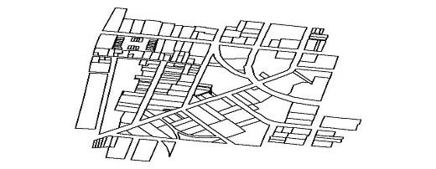
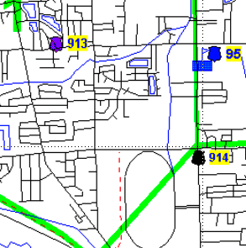
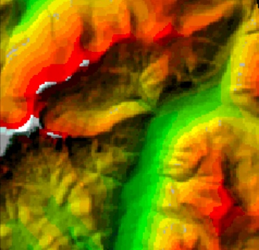
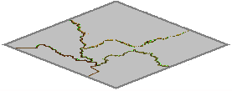
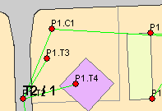
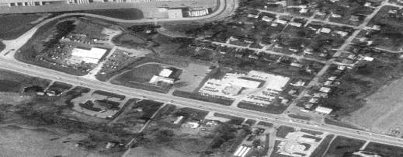
OFFICE OF BROADBAND AND GEOSPATIAL INITIATIVES
(OBGI)
PURPOSE:
  Coordinate Broadband and Geospatial activities in New Mexico
  Collaborate with State, Local, Federal, and Private entities
  Leverage returns on investments, economies of scale, and sustainability
OUTCOME:
  An integrated and statewide implementation of Broadband Infrastructure/Digital Literacy and Geospatial Technology that consolidates resources into actionable solutions.
Office of Broadband and Geospatial Initiatives

Slide 17
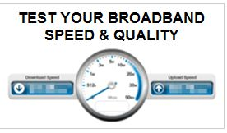
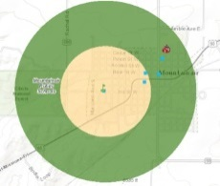
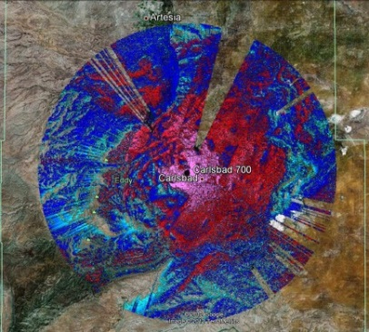
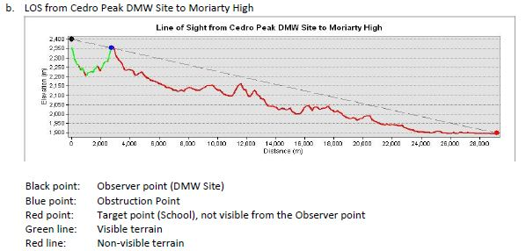
OBGI: Services and Resources
Coordination: Government, Industry, and Tribal
Reports: Strategic Plans, Sector Solutions, Education
Engineering: Network Design and Equipment
Testing: Network Performance and Speed Testing
Analytics: Propagation, Viewshed, Line of Sight, Co-Locate
Data: Infrastructure, Anchors, Business, and Residential
Mapping: Online and Map Products
Government Buildings
Health Facilities
Fire Facilities
CASA
GEODATA
BANK
Schools
Law
Enforcement
Interoperability
Emergency Centers
Correctional Institutions
Office of Broadband and Geospatial Initiatives
NM Broadband Program
  NMBBP: http://www.doit.state.nm.us/broadband/index.shtml

Slide 18
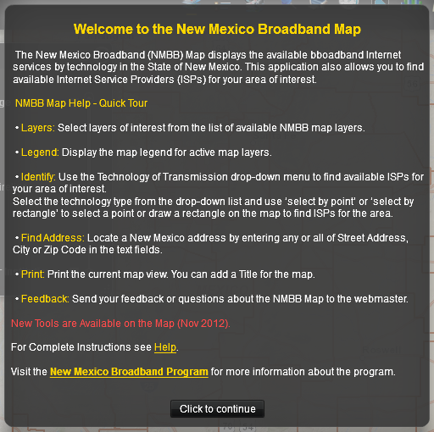
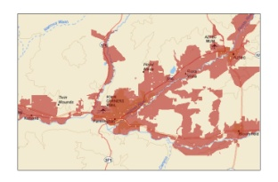
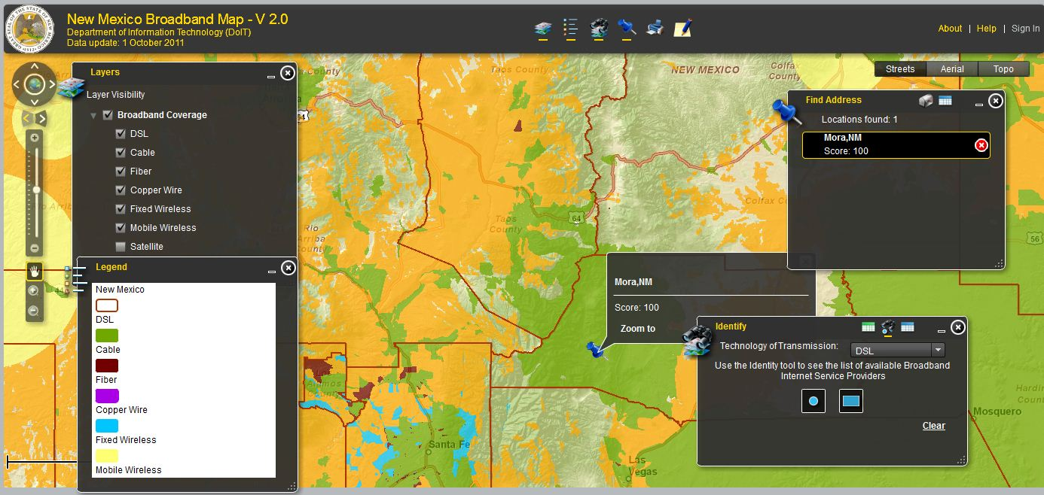
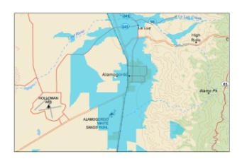
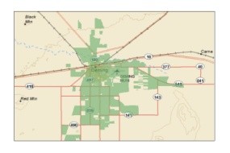
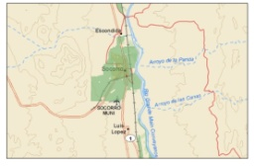
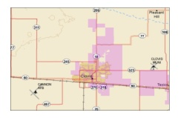
SERVICES: Mapping
New Mexico Broadband Map (Availability)
  Source – Internet Provider Data
    Type of Technology
    Provider Service Area and Contact
    Search – Address, Community, Area, or Point
NM Broadband Map: http://nmbbmapping.org/mapping/

Slide 19
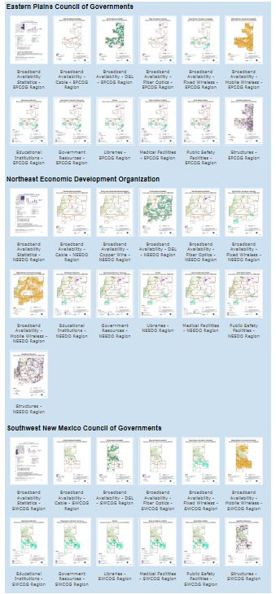
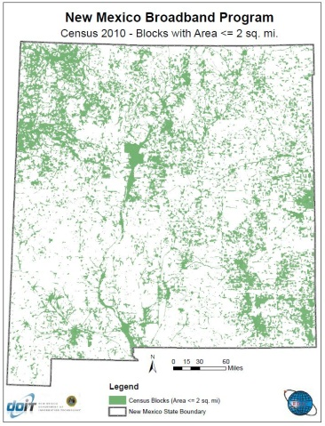
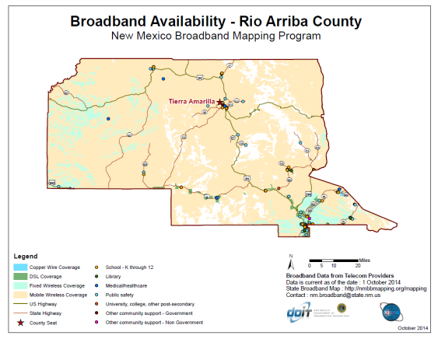
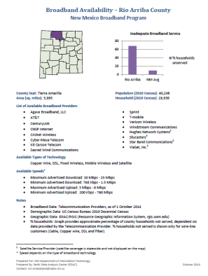
SERVICES: Broadband Maps
Broadband Map Gallery
  Statewide, Regional, and County Maps
    Broadband Availability and Technology
    Internet Providers
    Native Lands
    Telephone Exchange Boundaries
    Census Blocks
    Public Facilities
    Statistics and Demographics
    Administrative Areas
Statewide Map Gallery: http://www.doit.state.nm.us/broadband/map_statewide.shtml

Slide 20
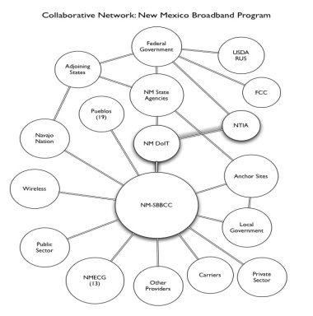
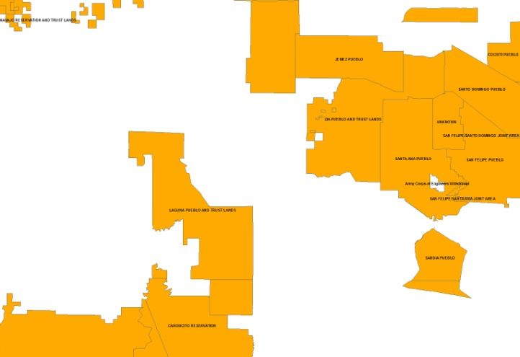
SERVICES: Coordination
Coordination & Collaborative Services
  Federal, State, and Local Governance
    Identify and assist in grant opportunities
  Regional Groups (COG, EDO)
    Gap Assessments, Capacity Analyses, and Cost Modeling
  Sectors (Health, Education, Business)
    Convening Schools, Library, and Health for Statewide Initiative
  Community Associations (Senior, Centers, Chambers)
    Support Implementation of Projects on Behalf of Communities
  Professional Groups
  Tribal Entities

Slide 21
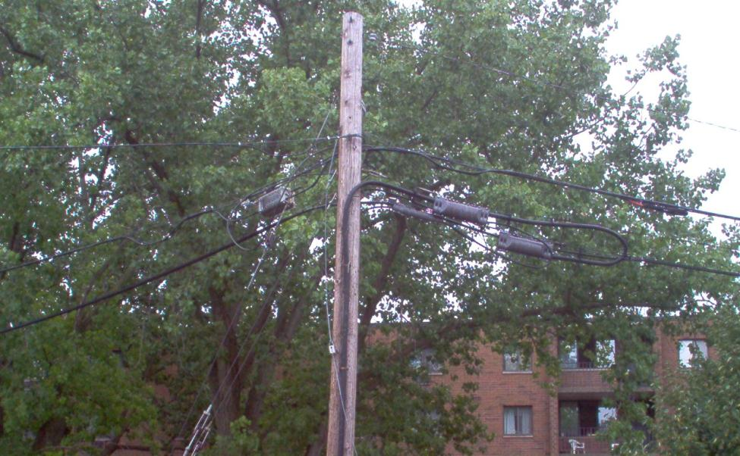
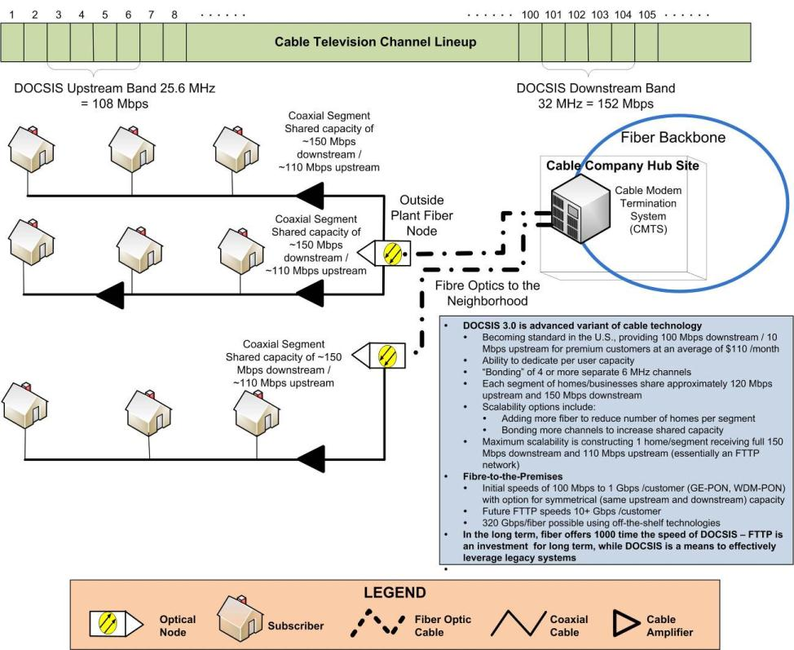
SERVICES: Reports
Statewide Strategic Plan
  Action Document
    Issues, Gaps, and Actions (Solutions)
    Administrative Structure, Governance, Industry, and Funding
    Major Sectors: Education, Health, Economic Development
Broadband Education/Training Strategic Plan
  Statewide Recommendations and Education/Training Portal
Strategic Business Sector Plans
  Business Sectors: Health, Education, and Economic Development
  Regional Implementation Plans
    Southwest New Mexico Council of Governments
    Northeast Economic Development Organization
    Northwest New Mexico Council of Governments
Over Twenty (25) Reports and Fact Memos
Reports: http://www.doit.state.nm.us/broadband/news.shtml

Slide 22
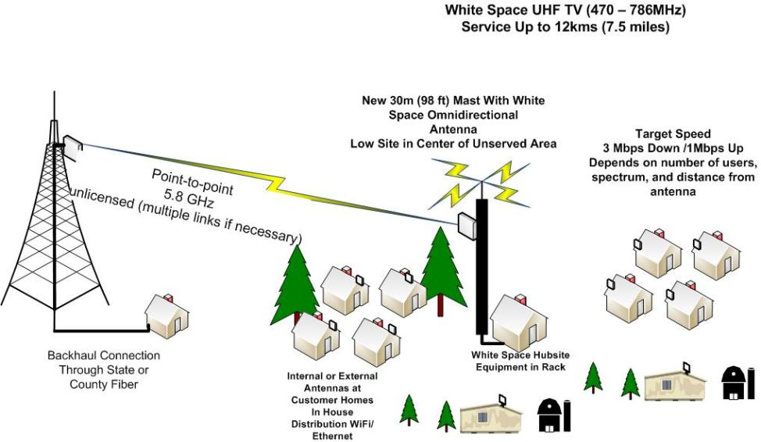

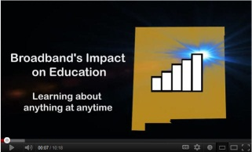
SERVICES: Assistance
Technical Assessment/Review
  General engineering design advisement
Broadband Education and Training
  One Stop Broadband Education and Training Site
  Business on the Web Training
New Mexico Broadband Videos
  Overview, Education, and Health
Public Internet Training & Access (PITA)
  Statewide Inventory (275+)
  Institutions, Content, Resources
Train the Trainer Program
  Locally Branded Content
  Targeting Professional Sectors
  Basic and Business Instruction
NM Broadband Videos: http://www.youtube.com/NMBroadband
Public Internet: http://www.nmbbmapping.org/pita/
Digital Literacy: http://nmconnect.org/
\

Slide 23
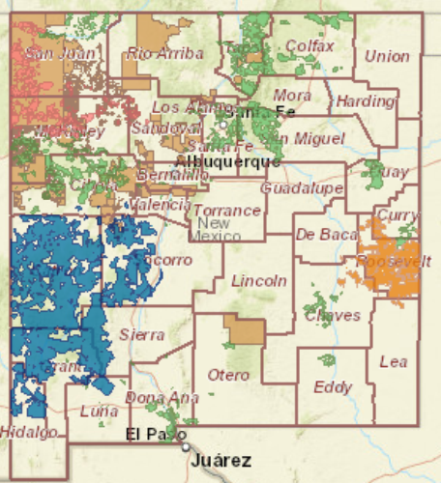
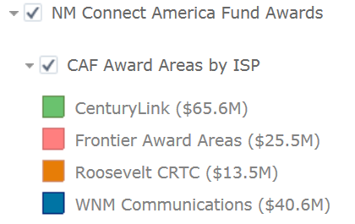
SERVICES: Assistance
Internet Service Providers
  Data processing and display of areas within the state Eligible for Federal Funding
  Example: Connect America Funds ($145M Awarded in New Mexico for Six Years)
USAC E-Rate Funds ($30M)
USAC Health Funds ($17M)
USAC CAF Funds ($145M)
PSCOC Funds ($50M)
PRC RUS Funds ($5M)
USDA RUS Funds

Slide 24
SERVICES: Data - CASA
  Community Anchor Site Assessment (CASA)
    Public and Private Facilities Requiring BB
    First in New Mexico within one Database
    Crowd Sourcing Update Application
Government Buildings
Health Facilities
Fire Facilities
CASA
GEODATA
BANK
Schools
Law
Enforcement
Interoperability
Emergency Centers
Correctional Institutions
NM Broadband Program
CASA Crowd Sourcing: http://nmbbmapping.org/bbcrowd/
Tutorial Video: http://www.youtube.com/NMBroadband

Slide 25
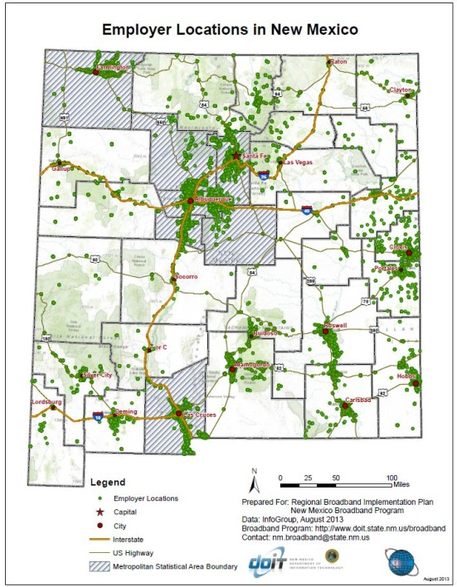
SERVICES: Data - Commercial
  New Mexico Business Data (200+ Data Items)
    Businesses Stratified by Sector (NAICS/SIC)
    Number of Employees
    Small Business Indicator
    Woman/Minority Owned
    Financials
    Computers
Restaurants
Plumbers
Architects
New Mexico
Commercial/Business
Data
Trucking
Solar
Builders
Ministries
CASA Crowd Sourcing: http://nmbbmapping.org/bbcrowd/
Tutorial Video: http://www.youtube.com/NMBroadband
NM Broadband Program

Slide 26
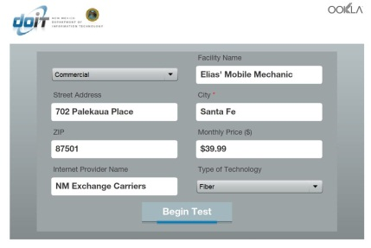
SERVICES: Testing
Network Performance Testing
  Public Institutions
  Identify Bumps
  Work with Industry for Solutions
Speed Test Performance
  Locally Served
  Speed Test Blitzing Projects
  Data Mapped and Analyzed
  Speed Test: http://www.doit.state.nm.us/broadband/speedtest.shtml
\

Slide 27
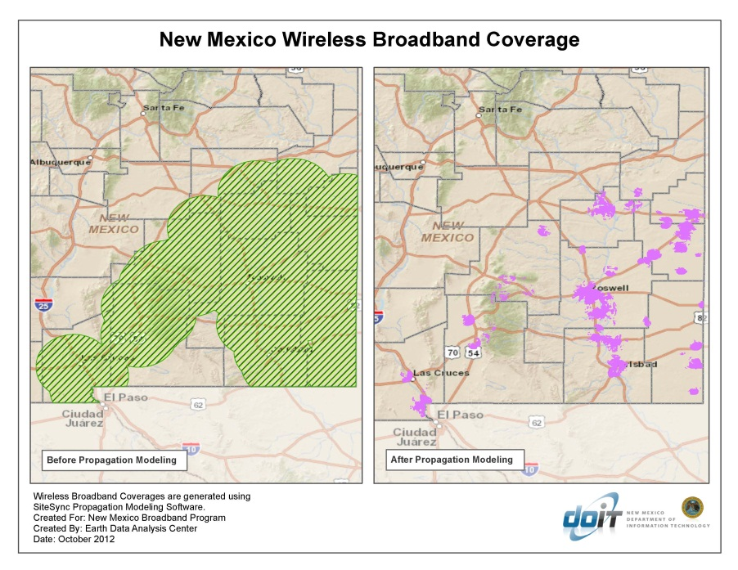

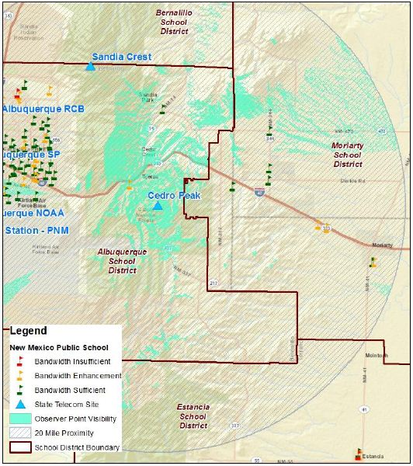

SERVICES: Analytics
Modeling
  RF Propagation Modeling
    Accurate Coverage
  Viewshed Analyses
    Twenty Mile Radius (WiFi)
  Line of Site Assessment
    Equipment Requirements
  Co-Location Design
    Establish Take Potential

Slide 28
OBGI: Broadband Initiatives - Structure
OFFICE OF BROADBAND INITIATIVES
NM Broadband Program
Education
BB4E
Businesses
BB4B
Health
BB4H
Libraries
BB4L
Residential
BB4R
Office of Broadband and Geospatial Initiatives

Slide 29
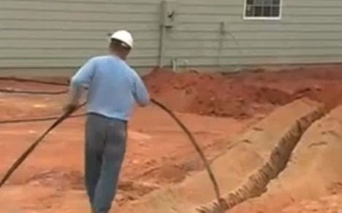
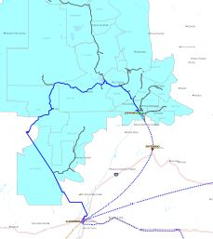

OBGI: Broadband for Education (BB4E)
Objective: Connect all schools by the last quarter of 2018 with 1 mbps per student/staff.
Process: Leverage E-Rate Funding
Resources:
  State Appropriation of $50M for five years ($10M per year)
  School Survey of Existing Conditions (840+)
  E-Rate Consultant Contract
  Facility and Infrastructure Mapping
Collaborative:
  Governor’s Office
  Education SuperHighway
  Department of Information Technology
  Public Education Department
  PSCOC Senate Bill 159
    Public Schools Facility Authority
    Broadband Deficiency Correction Program
  State Library
  Tribal Education
Office of Broadband and Geospatial Initiatives

Slide 30


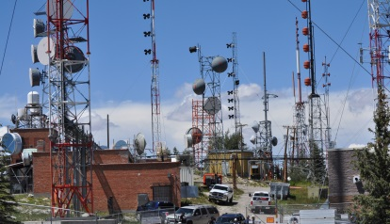
OBGI: Broadband Projects
BB4H: Broadband for Health (NMTHA)
  Leverage USAC Health Connect Funds
  Engage consultant assistance for application
  Utilize existing funds to provide match
BB4L: Broadband for Libraries (Broadband Task Force)
  Change library bond language to include broadband language
  Use bond funds for match
  Support Consortia with Schools to access E-Rate
  Conduct gap analysis and identify access and Wi-Fi needs
BB4C: Broadband for Communities
  Facilitate and provide technical coordination to communities
  Support alternative technologies to fiber (TVWS, DMV, etc.)
BB4S: Public Safety Broadband Network (FirstNet)
  Data Collection Activity and Plan Review – Towers/Critical Infrastructure
Office of Broadband and Geospatial Initiatives

Slide 31
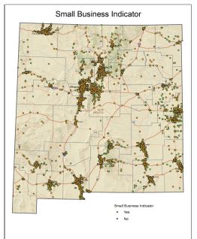
OBGI: Broadband for Businesses (BB4B)
Objective: Define level of effort to provide reliable and affordable Broadband Services to Businesses. Study currently in draft review.
Process:
  Assess capacity requirements and develop a cost model
  Research administrative options to implement a statewide BB4B Project
  Provide Business focused digital literacy content and web presence
Resources:
  Special State appropriation ($400K)
  Business data (Business Permits, Proprietary Sources, Survey)
  Speed Test Blitz
  NMBBP broadband availability and facility (CASA) data
Collaborative:
  Legislative – Interim Jobs Council
  Business Community – Associations, Economic Development, Commerce
  Government – Local and State Agencies (TRD, EDD, DOL, Regional, etc.)
Office of Broadband and Geospatial Initiatives

Slide 32
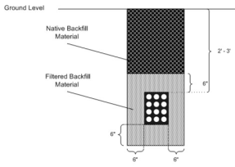
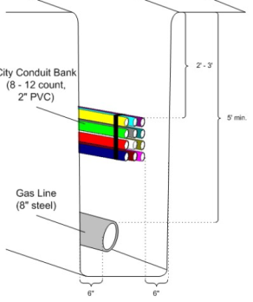
OBGI: BB4B – Policy Considerations
Short-Term Recommendations:
  Dig Once – Install conduit during construction
  Certification – Certify office buildings with robust broadband
  Competitive Awards - State grant/loan program to fund last mile projects
  Public-Private Partners - Public or Shared Risk P3 Models
  OBGI Funding – Continued support to the OBGI
  Collaborative Framework – Create a structure that is inclusive of all sectors
  ROW – Simplify the process for accessing Right of Way
  Co-Location – Leverage collective participation of anchor institutions
  Joint Purchasing – Launch RFP available to all levels of government
Long-Term Recommendations
  Make Ready – State enable “climb or one touch” during construction
  Infrastructure Bank – Low cost financing options
  Fund – Identify funding mechanism to match federal monies
  Non-Profit Collaborative – Digital Inclusion, funding, and direct public benefits
  BB4B: Report http://www.doit.state.nm.us/broadband/reports/BB4B_CTC_Report_Policy_Considerations-final20170117.pdf/
Office of Broadband and Geospatial Initiatives

Slide 33
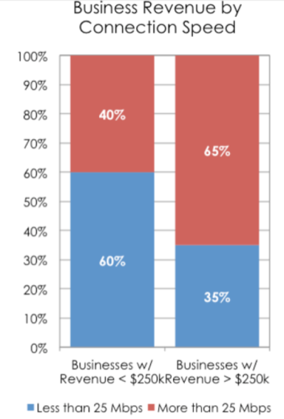
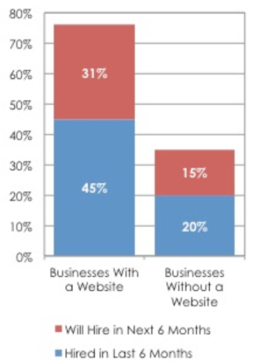
OBGI: BB4B – Digital Business Skills
Accelerates Commerce and Creates Jobs:
  Businesses with websites twice likely to hire within six months.
  Businesses with a service less than 25mb have less revenue
NM Connect:
  Website – Nexus for information and materials to improve broadband skills
  Sectors - Focused tabs for communities, education, and ECONOMIC DEVELOPMENT
  Info – Broadband and Employment
  Info – Broadband and Telecommuting
  Info - Broadband for Small Businesses
    Small Business Planning and Assessment
    Marketing
    Digital Marketing Myths
  Source: connectednation.org
  Source: Eric Frederick
  NM Connect: http://nmconnect.org/economic-development/
Office of Broadband and Geospatial Initiatives

Slide 34

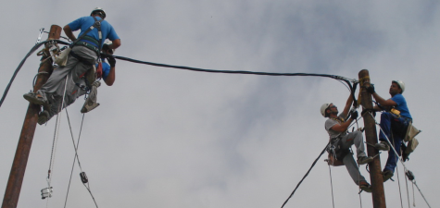
OBGI: BB4B – Funding Opportunities
Federal Offerings:
  Economic Development Administration Grants for Distressed Areas
    EDA Grants: https://eda.gov/grants/
  USAC Schools and Libraries USF Program – E-Rate
    E-Rate Grants: http://www.usac.org/sl/applicants/default.aspx
  USAC Rural Health Care Program
    Healthcare Connect Funds: http://www.usac.org/rhc/default.aspx
  USAC High Cost 0 Connect America Funds (Providers Only)
    CAF: http://www.usac.org/hc/
State Offering (In Development):
  NM Public Regulatory Commission Broadband Fund
    Workshop Schedule: http://www.nmprc.state.nm.us/
Listings and Descriptions:
  NMBBP BB4B: Preliminary Policy Considerations -
    http://www.doit.state.nm.us/broadband/reports/BB4B_CTC_Report_Policy_Considerations-final20170117.pdf/
  NMBBP Statewide Strategic Plan –
    http://www.doit.state.nm.us/broadband/reports/nmbbp_strategic_plan.pdf
  OBGI Reports: http://www.doit.state.nm.us/broadband/news.shtml
Office of Broadband and Geospatial Initiatives

Slide 35
THANK YOU
Contact:
Kendra Karp, Director Office of Broadband and Geospatial Initiatives
Gar Clarke, NM Broadband Program Manager
Broadband Portalhttp://www.doit.state.nm.us/obgi.shtml

Slide 36
Questions
Please type your questions in the questions box to the right of the screen and we will answer them in sequential order.

Slide 37
Upcoming FUNDIT Webinar
Accessing funding for your community’s projects: How to improve your approach
September 27th
2:00-3:30 pm
Registration URL: https://attendee.gotowebinar.com/register/7031994069911804162
Webinar ID: 628-325-763
Additional NM EDD FDT Events:
How to Use Brownfields Funding for Community Revitalization
August 31, 2017 @ Tucumcari Convention Center
NM EDD REDA Workshop: How to reduce energy consumption for small businesses and agricultural producers
September 19th @ KTAOS, Taos

Slide 38
Contact Us
Juan Torres, NM EDD
Johanna Nelson, NM EDD
Gar Clarke, DOIT
Email: george.clarke@state.nm.us
Office: 505.827-1663
Email: juan.torres@state.nm.us
Office: 505-827-0238
Email: Johanna.nelson@state.nm.us
Office: 505-827-0264
Kendra Karp, DOIT
Email: KendraL.Karp@state.nm.us
Office: 505-827-0214

